Slide 1
Case presentation
81F , fit and mobile
On HD 2017 via L BC AVF
Pacemaker on left side 2018
Previous arm swelling 2022
Fistulogram showed cephalic arch stenosis and more central stenosis due to PPM wires – plasty
Gradual worsening of arm swelling, progressively extended to armpit and left side of neck, limiting her daily life

Slide 2
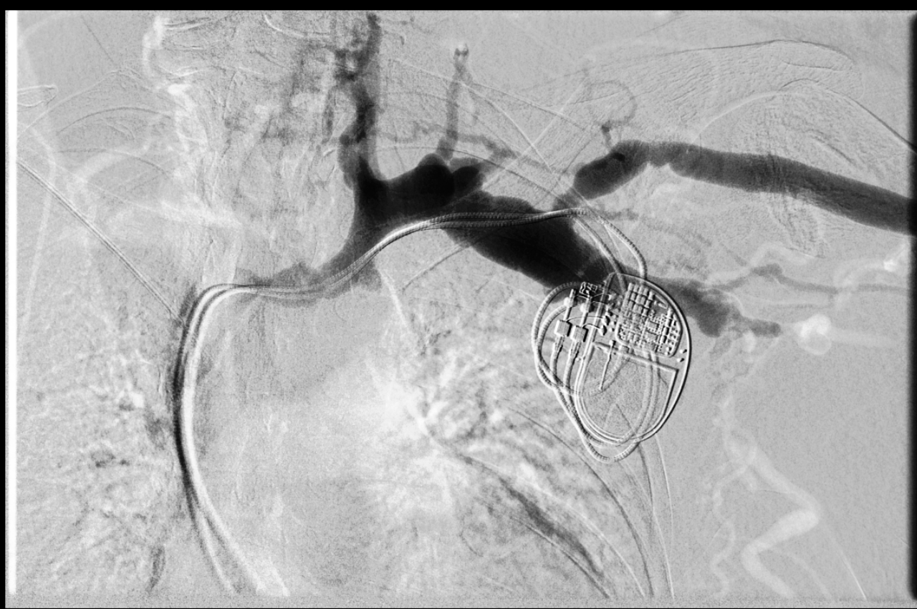
Case presentation

Slide 3
Case presentation
Quick worsening of symptoms
?ligation of AVF
?repeat plasty (over PPM wires?) – how long can we keep doing it
Other options?

